Slide 1

Hyperlocal Firm- Performance Improvement
Consultant : we Rize

Slide 2
Case I – Benefit Program to Incentivize Partners
Data Description
Partner ID - ID of the Delivery Partner
Date - Date
Supply Hours - Number of hours the partner was online on the platform on that day
Tasks - Number of deliveries the partner completed on that day
Constraints
CPT should below 0.9
Incentivize partners to stay longer time in the platform

Slide 3
Point Structure & Budget Summary
Structuring the reward system into three categories based on priorities
Daily points, Weekly bonus, Weekend bonus points for additional work hours
Base Points: 1 point per every hour in the platform
Weekly Points: At least 4 hours for all seven days – 50 points
Weekend Points: At least 8 hours on Sunday & Monday – 100 points
Obtain CPP, Budget Summary, CPT Impact on individual partner

Slide 4
Case II – Partner Quality model
Data Description
Partner ID - ID of the Delivery Partner
Date - Date
Tasks - Number of deliveries the partner completed on that day
Acceptance rate- (no. of tasks accepted by the partner)/(no. of tasks assigned)
Cancellation rate- (no. of tasks canceled by the partner)/(no. of tasks accepted)
Tasks not delivered- Percentage of tasks not delivered over accepted
Partner cancellation- Percentage of tasks where partner-induced cancellation
Task time- Average time taken by partners to deliver tasks
Interaction rate- Percentage of tasks where partner contacted support center
Contact rate- Percentage of tasks where partner contacted customer
Rating- Average rating given by customers (on a scale of 1-5)
Expectations
Partner Quality model
Plan of action if partner falls in retraining more than once.

Slide 5
Partner Quality Score
Identify the metrics which are important for assessing the partner quality
Assigning weights to each metric according to individual importance to each metric
Acceptance rate= 0.1
Cancellation rate= 0.1
Tasks not delivered= 0.2*
Partner cancellation = 0.1
Task time= 0.2*
Interaction rate = 0.05
Contact rate= 0.05
Rating = 0.2*
Note: (*) denotes primary metric
Avg Precision Quality score = 22
Threshold limit= less than avg. precision Quality= 20

Slide 6
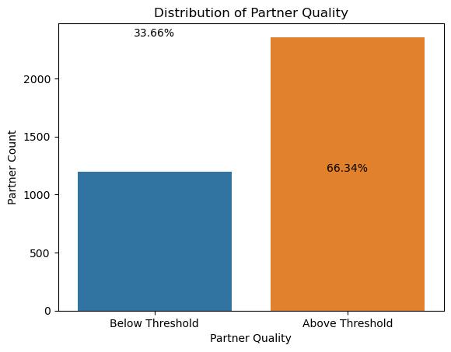
Plan of Action on retraining
33.36% of the partners are below the threshold value.
Conduct a performance review
Assign mentor
Continuous monitoring
Retraining performance Assessment

